Slide 1
Fruit Image Classifcation
Using DeepLearning

Slide 2
Data Source: Kaggle
The dataset contains images of apple, orange, banana and pineapple.
The model will detect label the image as apple, orange, banana, pineapple or none
Dataset link : https://www.kaggle.com/mbkinaci/fruit-images-for-object-detection/code

Slide 3
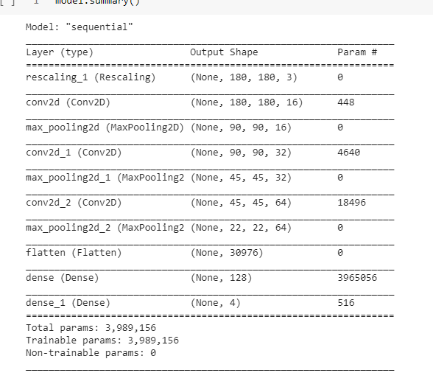
Architecture of the model

Slide 4
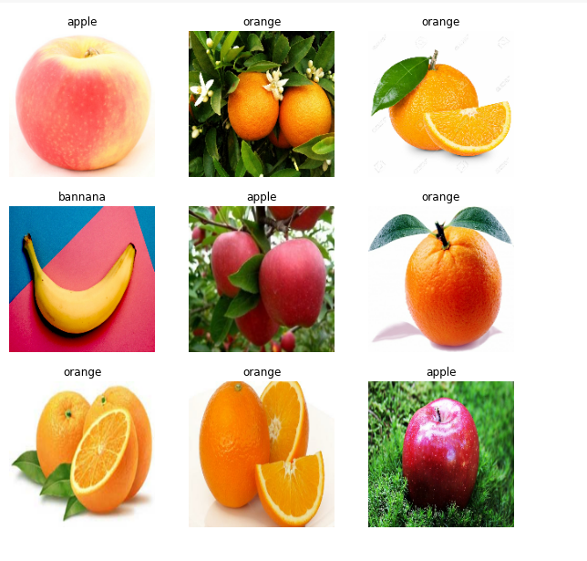
Sample Images

Slide 5
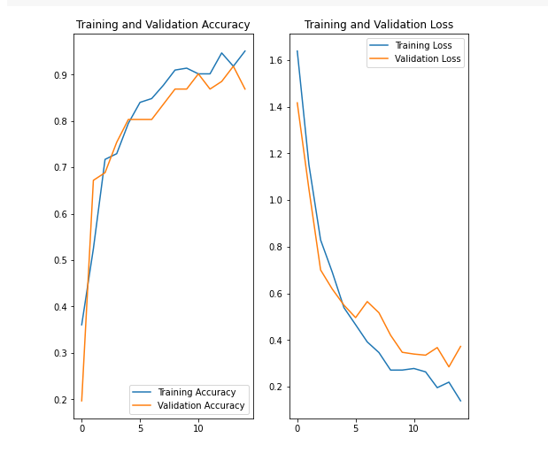
Visualization of the results of the training

Slide 6
Results and Conclusion
The CNN architecture is able to classify the images of 4 fruits with an accuracy of 93%.

